Slide 1
Introduction to Web Engineering
Lecture # 1

Slide 2
Web Engineering
Web engineering focuses on the methodologies, techniques, and tools that are the foundation of Web application and websites development.
Book: T. A. Powell and Powell, HTML & CSS the complete reference. New York: McGraw-Hill
Marks Division:
Office Hours:
Thursday: 11:00 PM to 12:30 PM
Friday: 10:30 PM to 12:30 PM
Office# CS-222
Quizzes | 10%
Assignments | 10%
Project + Task | 20%
Mid Term | 20 %
Final Term | 40%

Slide 3
Web Application
A Web application (Web app) is an application program that is stored on a remote server and delivered over the Internet through a browser interface.
A web application is application software that runs in a web browser, unlike software programs that run locally and natively on the operating system of the device.

Slide 4
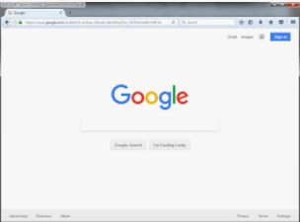
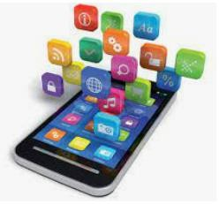
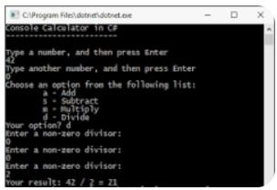
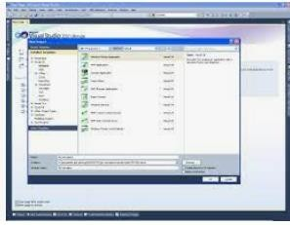
Types of Applications
Console Applications
Windows Application
Web Application
Mobile Application

Slide 5
Types of Web Applications
Static web application.
Dynamic web application.
E-Commerce web application.
Single-page web application.
Portal web application.
Content management system web application.
Animated web applications.
Rich Internet web applications.

Slide 6
Difference between Websites and Web Application
A website provides visual and text content that the user can see and read, but not affect in any way.
Web application, the user can not only read the page content but also manipulate the data on this page.
Web application is interactive for users. Web site is not interactive for users.
A website is a group of globally accessible, interlinked web pages which have a single domain name.
Web application is a piece of software which is accessed by the browser

Slide 7
Internet
The Internet, sometimes called simply "the Net," is a worldwide system of computer networks -- a network of networks in which users at any one computer can, if they have permission, get information from any other computer (and sometimes talk directly to users at other computers).

Slide 8
Internet Protocols
Transmission Control Protocol (TCP)
Internet Protocol (IP)
User Datagram Protocol (UDP)
Post office Protocol (POP)
Simple mail transport Protocol (SMTP)
File Transfer Protocol (FTP)
Hyper Text Transfer Protocol (HTTP)
Hyper Text Transfer Protocol Secure (HTTPS)

Slide 9
Transmission Control Protocol (TCP)
TCP stands for Transmission Control Protocol a communications standard that enables application programs and computing devices to exchange messages over a network.
It is designed to send packets across the internet and ensure the successful delivery of data and messages over networks.

Slide 10
Internet Protocol (IP)
The Internet Protocol (IP) is the method for sending data from one device to another across the internet.
Every device has an IP address that uniquely identifies it and enables it to communicate with and exchange data with other devices connected to the internet.

Slide 11
User Datagram Protocol (UDP)
User Datagram Protocol (UDP) is a communications protocol that is primarily used to establish low-latency and loss-tolerating connections between applications on the internet.
UDP speeds up transmissions by enabling the transfer of data before an agreement is provided by the receiving party.

Slide 12
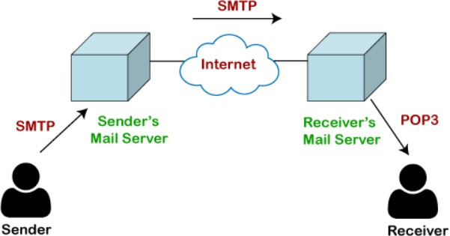
Simple mail transport Protocol (SMTP) / Post office Protocol (POP)
The post office protocol (POP) is the most commonly used message request protocol in the Internet world for transferring messages from an e-mail server to an e-mail client.
The Simple Mail Transfer Protocol (SMTP) is an Internet standard communication protocol for electronic mail transmission.

Slide 13
File Transfer Protocol (FTP)
The File Transfer Protocol (FTP) is a standard communication protocol used for the transfer of computer files from a server to a client on a computer network.
FTP is built on a client–server model architecture using separate control and data connections between the client and the server.

Slide 14
Hyper Text Transfer Protocol (HTTP) /
Hyper Text Transfer Protocol Secure (HTTPS)
HTTP is a protocol for fetching resources such as HTML documents. It is the foundation of any data exchange on the Web and it is a client- server protocol, which means requests are initiated by the recipient, usually the Web browser.
Hypertext Transfer Protocol (HTTP) is an application-layer protocol for transmitting hypermedia documents, such as HTML.
Hypertext Transfer Protocol Secure (HTTPS) is an extension of the Hypertext Transfer Protocol (HTTP). It is used for secure communication over a computer.
In HTTPS, the communication protocol is encrypted using Transport Layer Security or, formerly, Secure Sockets Layer.

Slide 15
URL (Uniform Resource Locator)
A Uniform Resource Locator, colloquially termed a web address, is a reference to a web resource that specifies its location on a computer network and a mechanism for retrieving it.

Slide 16
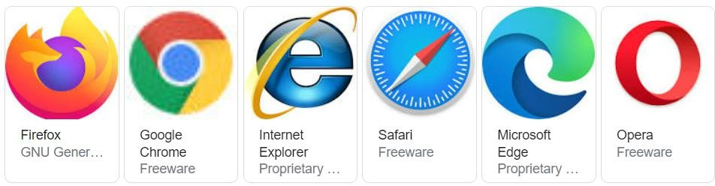
Web Browser
A web browser (commonly just called a browser) is application software for accessing websites. When a user requests a web page from a particular website, the browser retrieves its files from a web server and then renders the page on the user's screen.
Examples:

Slide 17
ISP (Internet Service Provider)
An Internet Service Provider (ISP) is a company such as PTCL, AT&T, Verizon, Comcast, or Spectrum that provides Internet access to companies, families, and even mobile users. ISPs use fiber-optics, satellite, copper wire, and other forms to provide Internet access to its customers.

Slide 18
Hyperlink
In computing, a hyperlink, or simply a link, is a digital reference to data that the user can follow or be guided by clicking or tapping.
Examples:
Wiki
Google

Slide 19
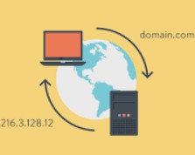
DNS (Domain Name System (DNS)
DNS, or the Domain Name System, translates human readable domain names (for example, www.amazon.com) to machine readable IP addresses (for example, 192.0. 2.44).

Slide 20
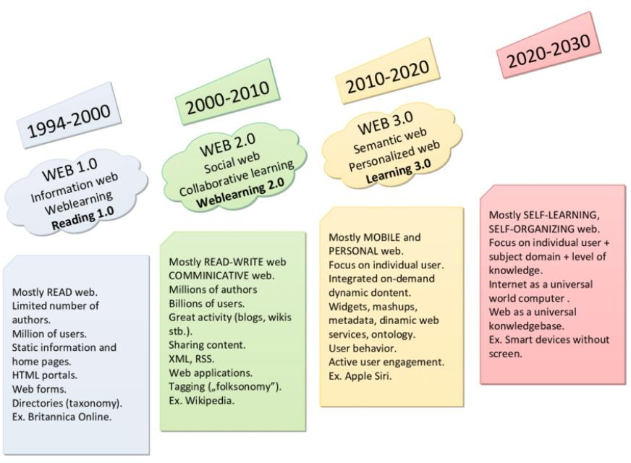
Web Generations

Slide 21
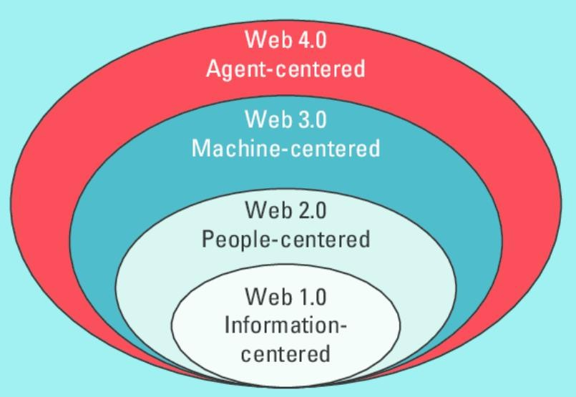
Web Generations

Slide 22
What is a Web site?
A collection of related documents available on the Web
The first portion of the URLs in the Web pages of a Web site is the same e.g.
http://www.riphahfsd.edu.pk/
http://www.riphahfsd.edu.pk/uzair
Are the URLs of three distinct Web pages on a single Web site

Slide 23
What is a Web Search Engine?
Search engines continuously scan the Web and compile a list of all the Web pages that they find
The search engine with the largest such list (or index) is Google – with a list of over 2 billion Web pages and over 330 million images
We use the search engine by typing a “search key word” or “query” on its Web page. It looks for those keyword in its index, and displays a list of Web pages that contain that keyword

Slide 24
I know I can read off the Web. Am I allowed to put my stuff on the Web?
Yes. You just need to have a computer that is hooked up to the Internet.
You do not require anyone’s permission to put your Web page(s) on the Web
Your Web page will be available to all the millions of users that have access to the Internet the moment you place it on the Web

Slide 25
Impact of the Web on Computing
Every one wants to use the Web
That has spurred the demand for computers
That, in turn, has reduced the cost of computing drastically
The computers are becoming easier to use because the target users are becoming less and less sophisticated
In the olden times only techies used computers; now my 4-year old knows things about the machine that I never did

Slide 26
Impact of the Web on Society
User friendly communication has become much more affordable – the global village is shrinking
Business persons can stay in touch with their businesses even without being there – for some, that has resulted in the destruction of their family life

Slide 27
Impact of the Web on Commerce
Huge impact
The moment I take my business to the Web, it becomes possible for my customers to find out about me without me being physically present in their city
Suddenly, I’m running a global business

Slide 28
The Future: The Semantic Web
What unique feature distinguishes the Web of today with the Semantic Web of tomorrow?
Whereas, today’s Web’s content is designed for humans to read; the Semantic Web’s content will be designed for computers to understand meaningfully
However, the Semantic Web is not a replacement but an extension of the present Web, in which information is given well defined meaning

Slide 29
The Semantic Web
Some progress is already being made for adding “Semantic Content” on to the Web, but a lot more will happen in the next 5 years
To find further info about this exciting development read Tim Berner Lee and his co-worker’s paper: “The Semantic Web” that is available on the Web as:
http://www.sciam.com/2001/0501issue/0501berners-lee.html

Slide 30
Web Application Architecture

Slide 31
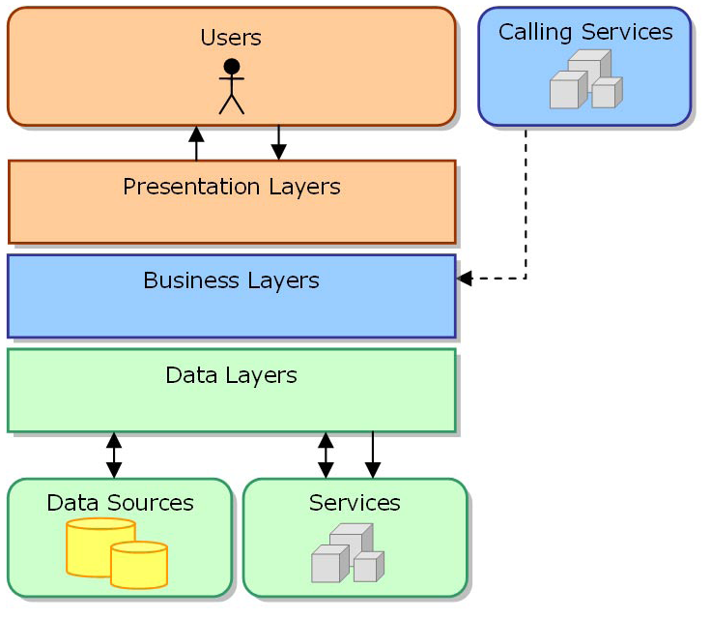
Layers
Figure shows a simplified view of one application and its layers.

Slide 32
Layers
It is important to note that the layers are merely logical groupings of the software components that make up the application or service.
They help to differentiate between the different kinds of tasks performed by the components.
The make it easier to design reusability into the solution.
Each logical layer contains a number of discrete component types grouped into sublayers, with each sublayer performing a specific kind of task.
By identifying the generic kinds of components that exist in most solutions, you can construct a meaningful map of an application or service, and then use this map as a blueprint for your design.

Slide 33
Evolution of Enterprise Application Framework for C/S Arc
Single tier
Two tier
Three tier
RPC based
Remote object based
Three tier (HTML browser and Web server)
Proprietary application server
Standard application server
N-Tier

Slide 34
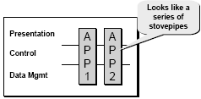

Client-server architectures 1-tier Architecture
Entire application exists on single node
Installed on individual machines
Dumb terminals are directly connected to mainframe
Centralized model (as opposed distributed model)
Presentation, business logic, and data access are intertwined in one monolithic mainframe application
Types of systems
Standalone executable
Mainframe applications

Slide 35
Client-server architectures 1-tier Evaluation
Advantages
Simple to build
Natural
No client side management is required
Data consistency is easy to achieve
Disadvantages
Facilitates very little reuse
Maintenance can be expensive
Single point of failure
Scaling systems requires buying bigger, costly hardware

Slide 36
Client-server architectures 2-tier Architecture
Client Server Applications
The client and server can be heterogeneous
Different implementation languages
Different operating systems
The roles can be transient
Fat client – server only manages data
talk to back end database
SQL queries sent, raw data returned
Some Windows GUI based application
Thin Client – server manages data and business logic
Browser – server manages presentation too

Slide 37
A client-server system

Slide 38
Client-server architectures 2-tier Evaluation
Advantages
Modifications on server propagated to clients
Can distribute processing load
Better scalability by adding server nodes and clients
Database type independence
Disadvantages
Client nodes require more computing power
Development and maintenance more complex
Presentation, data model, business logic are intertwined (at client side), difficult for updates and maintenance
Data Model is “tightly coupled” to every client: If DB Schema changes, all clients break
Updates have to be deployed to all clients making System maintenance nightmare
DB connection for every client, thus difficult to scale
Raw data transferred to client for processing causes high network traffic

Slide 39
A client-server ATM system

Slide 40
Three Tier Architecture
Three-tier architecture is a well- established software application architecture that organizes applications into three logical and physical computing tiers: the presentation tier, or user interface; the application tier, where data is processed; and the data tier, where the data associated with the application

Slide 41
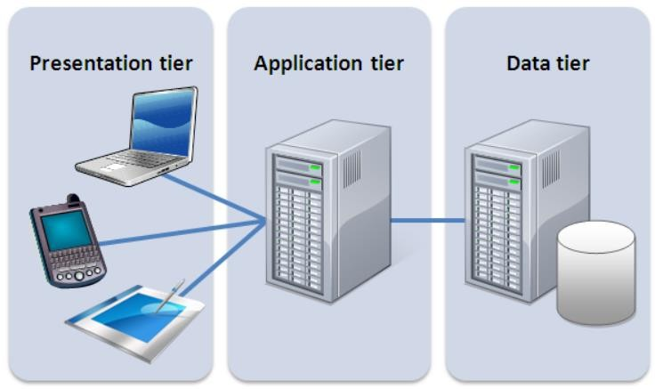
Three Tier Architecture

Slide 42
Three Tier Architecture
The Presentation tier - the part of the application which is visible to the user; it enables the input of requirements and the presentation of results.
The Application tier (also functional) - the middle layer of the model (middleware), it assures the calculations and operations performed between input-output requirements and data. Also known as the application server.
The Data tier (also database) - the lowest layer of the model, it ensures all operations with data, i.e. database management system and basic data-base operations for functional storage, selection, aggregation, processing, integrity, and data audit.

Slide 43
Client-Server Architecture
This pattern consists of two parties; a server and multiple clients.
The server component will provide services to multiple client components.
Clients request services from the server and the server provides relevant services to those clients.
The server continues to listen to client requests.
It uses the concept of distributed computing
It is most widely used distributed system architecture

Slide 44
Client-Server Architecture
A server is a machine which provide the services to the clients
Server is a machine that takes requests and provide responses.
There might more then one clients and server machines in the network.
Today most common example of server is web servers that provide you web pages (works using HPPT protocol).
A server can also provide more then one services at the same time

Slide 45
Client-Server Architecture
Usage
Online applications
Email
Document sharing
Banking.

Slide 46
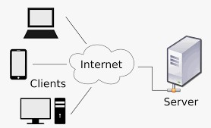
Client-Server Architecture
Figure 2.2: Client- Server Architecture

Slide 47
Web Service
A web service is any piece of software that makes itself available over the internet and uses a standardized XML messaging system.
A web service is a software system that supports interoperable machine-to-machine interaction over a network.
Web services are open standard (XML, SOAP, HTTP, etc.) based web applications that interact with other web applications for the purpose of exchanging data. Web services can convert your existing applications into web applications.

Slide 48
Software As A Service
Software as a service (or SaaS) is a way of delivering applications over the Internet—as a service.
Instead of installing and maintaining software, you simply access it via the Internet, freeing yourself from complex software and hardware management.

Slide 49
SaaS
Instead of developing Software purchase services from third party
Like automate a university system, HR system etc.
Here we will move to a company that already has solution to our problem
It is normally paid and data is on cloud
Common example Dropbox, gmail

